Slide 1
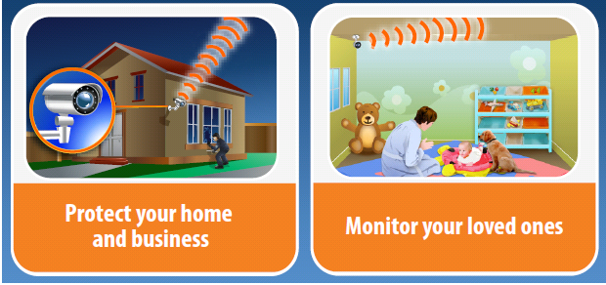
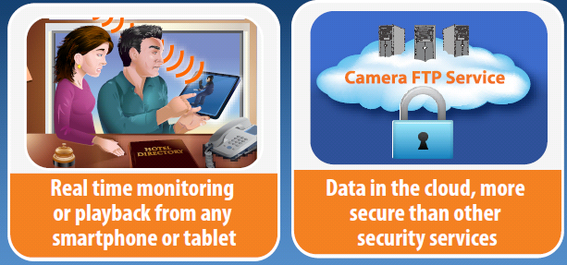
CameraFTP Overview
ADT, Comcast, AT&T and other security services charge $30 to $100/month, plus expensive hardware and professional installation
CameraFTP is a revolutionary and disruptive service. With the latest Cloud based technologies, our service price starts at only $1.50/month!

Slide 2
About CameraFTP
CameraFTP offers cloud-based security & monitoring service for homes & businesses.
It has many advantages over traditional security services.
Starts at only $1.50/camera/month, the price is 10 times lower that other security services.
CameraFTP is a subsidiary of DriveHQ, the first cloud IT solution provider founded in 2003. Based in Silicon Valley, DriveHQ has over 1.8 million registered users from all over the world and across many industries.

Slide 3
CameraFTP Services
Home security & monitoring service;
Business security & monitoring service;
Monitoring your loved ones (kids, pets, elderly, etc.);
Monitoring business activities;
Monitoring construction sites;
Monitoring public places;
Monitoring large events;
Community monitoring and crime prevention;

Slide 4
CameraFTP Advantages
Easy to setup
NO special hardware or professional setup are required.
NO technical expertise on DDNS, Router and Port Forwarding are required.
Low cost
10 times lower than traditional security services.
Flexibility
No contract lockup, no hardware lockup.
Better security
Cloud-based recording. Data is protected in our secure datacenter.
Remote monitoring and playback
Using a web browser, smart phone or tablets from anywhere.

Slide 5
CameraFTP Features (1)
Far more features than other security services:
Cloud storage for security cameras
No DVR, computer or other storage devices needed.
Fully optimized FTP service for security cameras
24x7 cloud-based recording
No need to manually monitor it. It records data for you, so you know what has happened. Your evidences are preserved.
Play back the recorded data
You can play back the recorded data from anywhere at anytime.
Real-time monitoring

Slide 6
CameraFTP Features (2)
Download the recorded data
You can preserve the recorded data by downloading it using a browser or any FTP client.
Camera status notification
If your camera stopped uploading data for certain amount of time, the system can send a notification email to you. You can ensure your camera is working 24x7. This is better than event-triggered notification.
Advanced security features
10 years of track record in offering Cloud-based services;
The unique “Camera Admin Mode” makes it extremely secure. An intruder cannot delete your recorded data even with your username and password!

Slide 7
CameraFTP Features (3)
Share camera to other people
Share camera to other users, incl. CameraFTP members and non-members.
Share different cameras to different users;
Publish camera for anybody to view
Publish camera for anybody to view. For example, monitoring the highway traffic, the entrance of a busy shopping center or a public event.
Group account
Mainly designed for businesses with multiple locations. You can create a sub-account for each location. A sub-user can only access the cameras at his location. The group owner can manage all cameras and sub-accounts.

Slide 8
CameraFTP Features (4)
Video / audio support
If your camera supports uploading video clips to the cloud, then CameraFTP supports it.
Most security cameras can only upload images. CameraFTP can play the recorded data like a video.
Uploading images instead of video clips has some advantages:
Most security cameras cannot upload videos.
The bandwidth & storage requirements are lower, so the service cost is also lower, but it still records important data.
ADSL and Cable Modem’s upload bandwidth is too small and often is not fast enough to upload videos, esp. if you have more than 1 cameras, or if your frame rate is high.
Most security cameras already support real-time video (and audio) monitoring through a web browser. The drawbacks are:
It requires technical expertise on IP address, DDNS service, router and port forwarding.
Your camera is less secure as it needs to be accessible from the Internet.
It only supports real-time monitoring without recording.

Slide 9
Reseller Programs (1)
Group Account Reseller Program (with custom logo and landing page service)
This is the easiest Reseller Program and can be setup instantly.
A reseller can create a group account, he can setup a custom landing page, and customize the website with his own company logo;
He can create sub-accounts for his customers; he can then order subscriptions for the sub-accounts. He can configure the cameras for his customers or provide the account information to his customers.
Customers will pay the reseller directly. The reseller will receive a special reseller discount from CameraFTP.
To setup, please sign up a free account and then contact CameraFTP sales.
Co-branded Reseller Program
You may consider the co-branded service if you can sell at least $2000/year and you want to:
customize the website look and feel, or
target a different market / different language, or
let your customers sign up and order the service online themselves
The cobranded service offers a reseller website for you at:
http://USERNAME.vosibiz.com/
You can customize your logo, company name, contact information; you can also download the website template files and fully customize the look and feel.

Slide 10
Reseller Programs (2)
White Label Reseller Program
It is almost identical to the co-branded program, except:
You can use your own website domain name.
The co-branded website is shared among all co-branded resellers, therefore the cost is lower; White label service requires a separate website, static IP address & SSL certificate. The setup & maintenance costs are much higher.
White label service usually means you will customize the website more thoroughly. You must have a team to customize the website for you based on our website templates. (We don't provide customization service)
To be a white label reseller, you must meet the following criteria:
Have a team to customize the website for you.
Have a strong brand name, or large customer base, or large sales channels, a high marketing budget.
Must be able to sell at least $8,000/year.
It is recommended using Group Account Reseller program or co-branded program. You can leverage on DriveHQ and CameraFTP’s strong brand name.

Slide 11
Facility
CameraFTP’s datacenter is co-located with Hurricane Electric in Fremont, California. (One of the largest global Internet networks since 1994)
The datacenter features:
Redundant power supplies, UPS and backup generators
Redundant Internet connections, multi-paths to most locations in the world
24x7 onsite security, surveillance cameras, automatic monitoring & alarm system
Virtually unlimited network bandwidth and storage capacity
Fully redundant hardware - no single point of failure

Slide 12
Security & Privacy Policies
We follow the industry’s top security and privacy practices.
Only senior operations personnel can access the data center. All activities are logged to ensure accountability and strict adherence to procedures.
We have a 24x7 automatic monitoring system which detects system problems, abuses, or intrusions. Network administrators are notified immediately of any problems.
All employees are required to have strong passwords and must change them periodically.
New security patches are tested and installed as soon as possible.
Firewalls, security software, and anti-virus software.

Slide 13
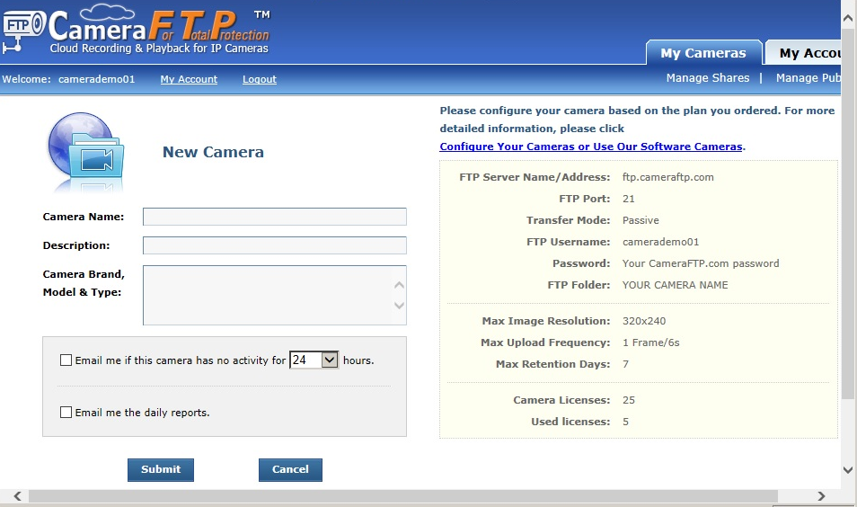
Appendix
The add camera screen

Slide 14
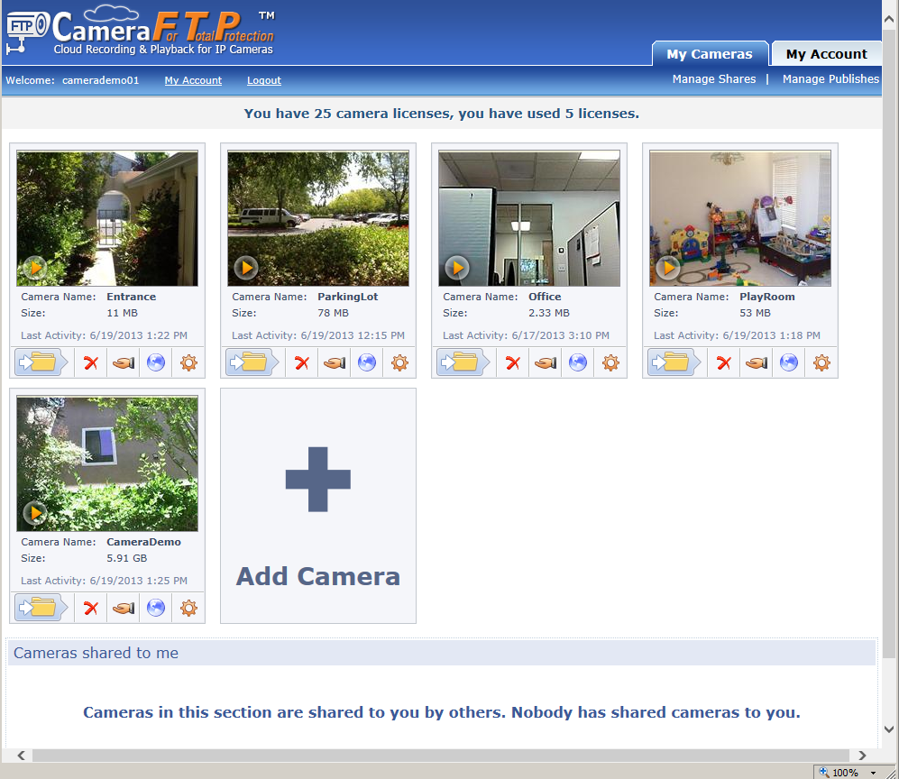
The camera list screen

Slide 15
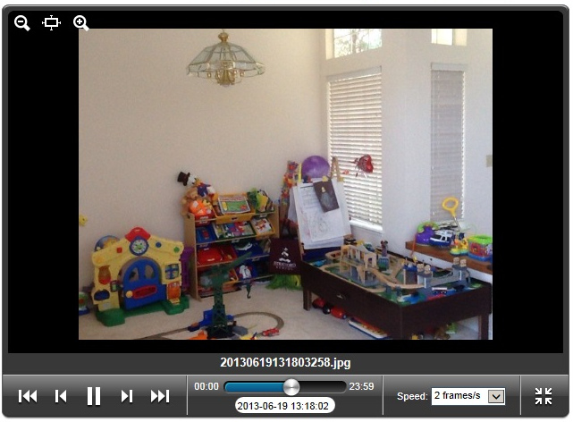
The camera player screen

Slide 16
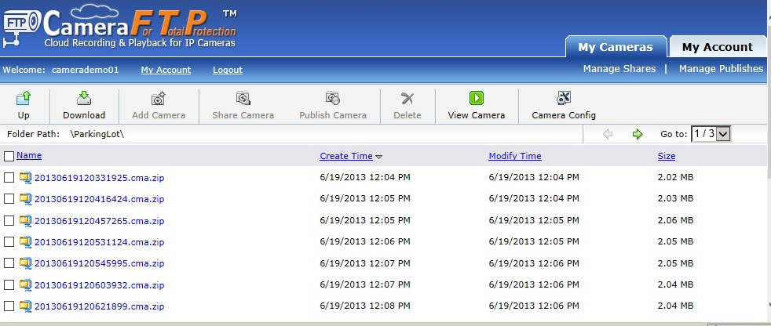
View file list: images are packed in zip format

Slide 17
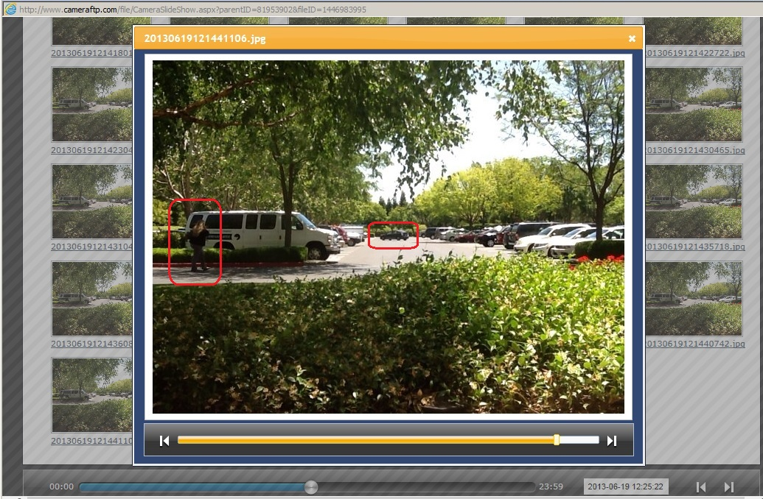
View image thumbnails and enlarged view

Slide 18
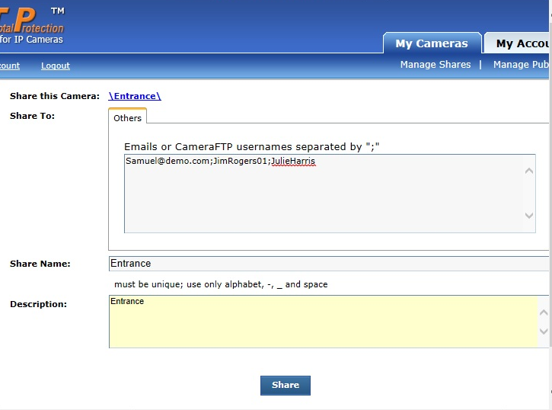
Share a camera to other people

Slide 19
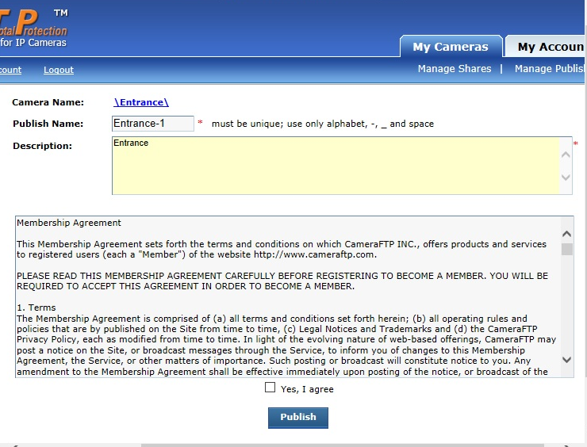
Publish a Camera

Slide 20
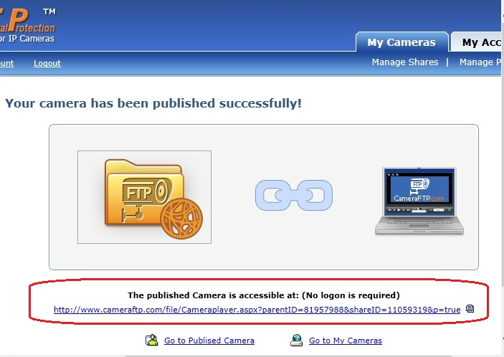
A camera is published, use the static URL to view the camera

Slide 21
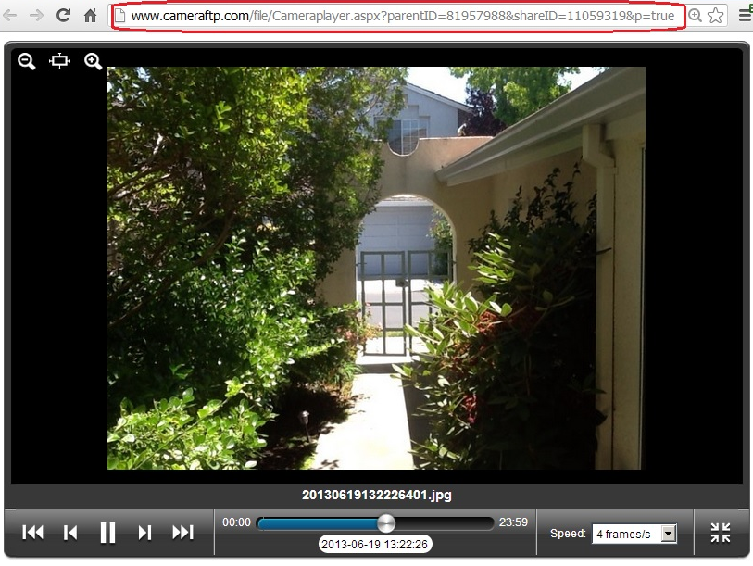
View published camera using the static URL

Slide 22
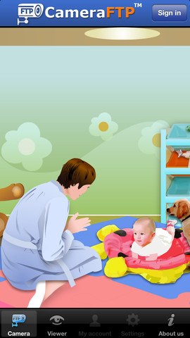
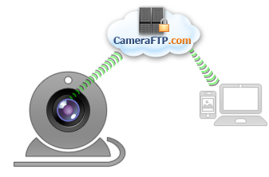
Mobile Viewer App
Remotely monitor or play back from anywhere at any time
Mobile Security Camera
Turn your smart phone or tablet into a Cloud-based security camera
Webcam FTP Service
Turn your webcam or laptop into a Cloud-based security camera

Slide 23
Some of our clients include…

